Slide 1

HAMBURG RACE PREVIEW
Race Analysis · July 9 – 12, 2026
USA Triathlon High Performance

Slide 2
Race Week Schedule
Hamburg
July 9 – 12, 2026 • Rathausmarkt / Binnenalster, Hamburg, Germany (CEST, UTC+2)
Fri • July 10
Sat • July 11
Sun • July 12
Familiarization & Briefing
ELITE SPRINT RACE DAY
Mixed Relay Day
TBD | Course familiarization — swim, bike, run circuits
TBD | ★ Mandatory Elite athlete briefing
TBD | Race package distribution
11:30 – 12:45 | Elite Men — athletes' lounge check-in + warm-up
12:15 – 13:00 | Elite Men — swim warm-up + transition check
13:10 | Elite Men — athletes' introduction
13:15 | ★ ELITE MEN START
~14:06 | Elite Men — projected finish
14:15 | Elite Men medals ceremony
13:45 – 14:45 | Elite Women — athletes' lounge check-in + warm-up
14:15 – 14:55 | Elite Women — swim warm-up + transition check
14:50 | Elite Women — athletes' introduction
15:00 | ★ ELITE WOMEN START
~15:55 | Elite Women — projected finish
16:05 | Elite Women medals ceremony
Evening | Mixed Relay team declaration
TBD | Mixed Relay team managers' meeting
17:30 | ★ MIXED RELAY START
~18:45 | Mixed Relay projected finish
Post-finish | Mixed Relay medals ceremony
Times Rathausmarkt / Binnenalster, Hamburg, Germany (CEST, UTC+2). Schedule confirmed from World Triathlon race-info page / athlete guide; subject to organiser updates.

Slide 3
Key Course Differentiators
Hamburg
HAMBURG
COURSE AT A GLANCE
WTCS Hamburg is one of the sport's flagship city-center races, set in the heart of Hamburg along the Binnenalster and the historic Rathausmarkt. This is the first year that the city is hosting a Para Series event.
Swim:
750 m – 1 lap
Bike:
17.8 km – 2 laps × 8.4 km
Run:
5.4 km – 3 laps × 1.8 km
Format:
Sprint Triathlon
Bike Laps:
2
COURSE FEATURES
Run Laps:
3
• Sheltered 750 m Binnenalster swim. Typically flat fresh water. Pontoon start and likely a non-wetsuit swim.
QUICK LINKS
Current Race Info:
• 2 × 8.4 km urban bike (17.8 km). Flat but highly technical course with multiple turns.
Race Info | 2026 World Triathlon Championship Series Hamburg
• 3 × 1.8 km flat run through city-center streets. Despite some cobblestone sections this is typically a fast run that comes down to a late surge.
• Sunday 13:45 Start Time

Slide 4
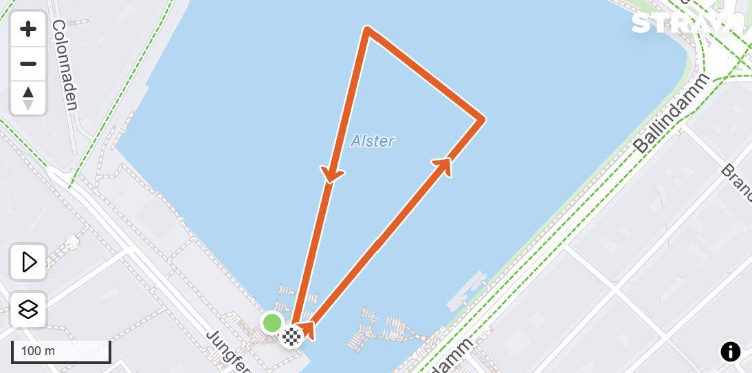
Swim Course Profile
Hamburg
750 m • single lap
Sheltered urban lake — fresh water, calm conditions
Distance
Body of Water
Start
750 m
River
Pontoon start
[Drop swim course map here] Save the organiser map as: ppt files/support/hamburg_swim_course.png It will be embedded automatically on the next run.
Water Temp
Wetsuit
Lap Count
18.0–22.0 °C
N/A
1
Tactical Notes
• Single 750 m loop with a pontoon start into the Alster canal.
• Fresh water lake in city center. Typically calm conditions
• July morning water mid-to-high teens Celsius.
Source: World Triathlon race info — 2026 WTCS Hamburg
• Finish in same starting location

Slide 5
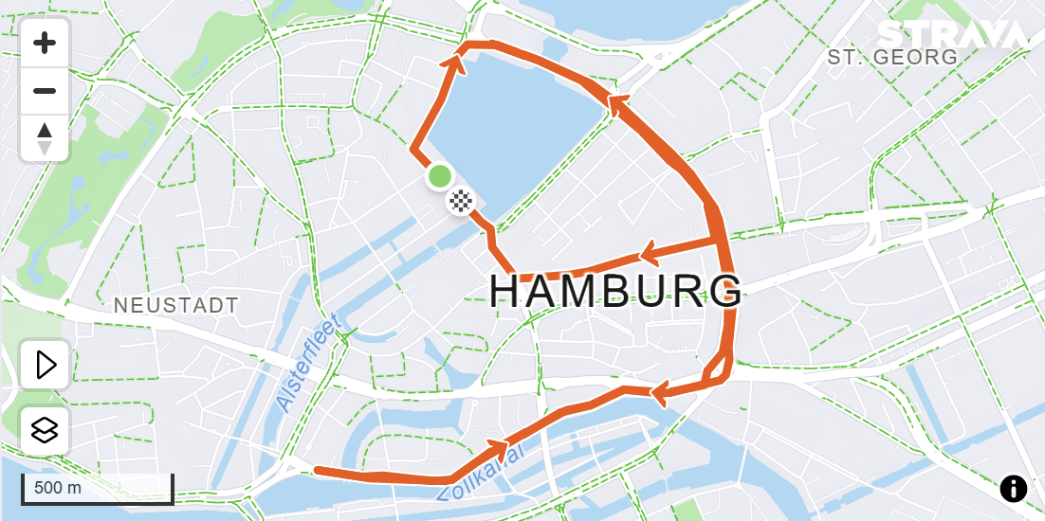
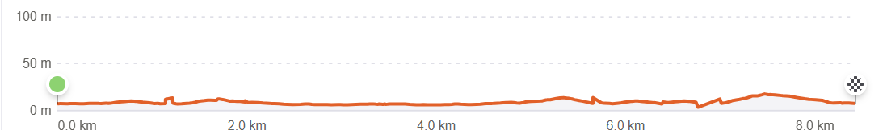
Bike Course Profile
Hamburg
17.8 km • 2 × 8.4 km loops?
Closed urban circuit — Rathausmarkt, Alsterufer, Jungfernstieg
[Drop course map here] Save the organiser course map as: ppt files/support/hamburg_bike_course.png It will be embedded automatically on the next run.
Elevation / Lap
Total Climb
Avg Grade
41 m / lap
?ft
~0-1%
Max Climb Grade
Wind
Loops
7%
City-center setting
NA
Tactical Implications
• Hamburg's city center bike represents one of the most technical WTCS bike courses. Pancake-flat throughout, but high-frequency turns reward bike-handling skills alongside power.
Source: World Triathlon race info — 2026 WTCS Hamburg
• Cobblestone sections add additional complexity
Flat course — published profile shows no significant climbs. No elevation chart synthesized; if a race GPS FIT becomes available, real contours will replace this block.

Slide 6
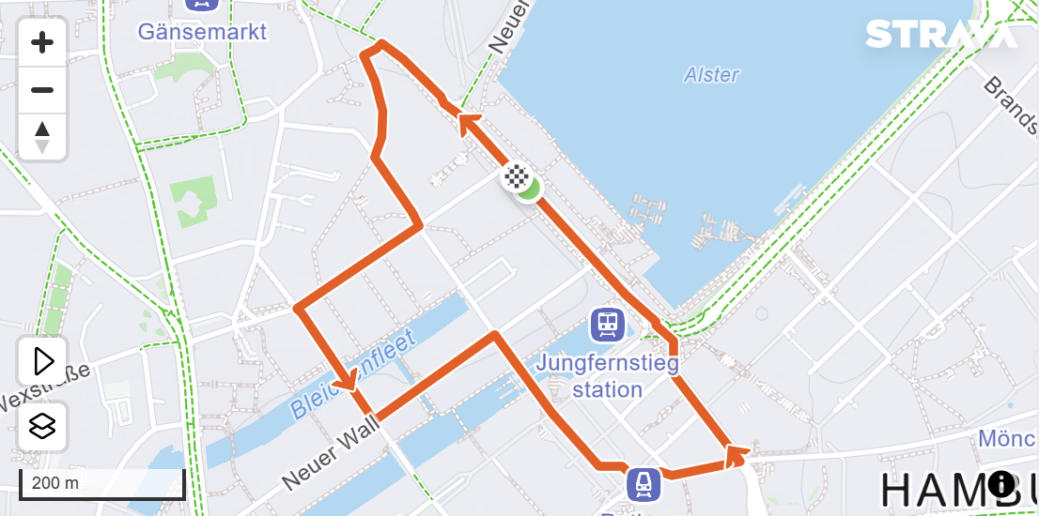
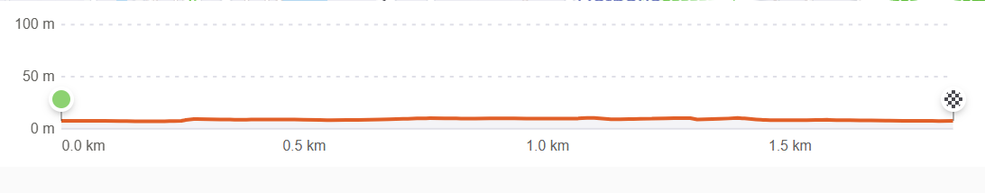
Run Course Profile
Hamburg
5.0 km • 3? × 1.8 km
Closed urban — Rathausmarkt, Alsterarkaden, city hall precinct
Distance
Lap Structure
Total Climb
5.0 km
3 X1.8 km
6 m
[Drop run course map here] Save the organiser map as: ppt files/support/hamburg_run_course.png It will be embedded automatically on the next run.
Avg Grade
Max ▲ / ▼
Heat Risk
~0-1%
+ 1.8%
LOW–MODERATE
Tactical Notes
• 3 X 1.8 km laps through Hamburg's historic city center offers a flat, fast, and most importantly a spectator-dense course
• Cobblestone sections add additional terrain from typically road surfaces.
• July Hamburg averages ~22 °C, manageable but warm
Source: World Triathlon race info — 2026 WTCS Hamburg

Slide 7
Travel & Arrival Load
Denver, CO → Hamburg race week
Core travel read
Denver → Hamburg requires one or two stops. Typical routes connect through London (LHR), Amsterdam (AMS), Frankfurt (FRA), or Paris (CDG) before the short connection into Hamburg (HAM). Lufthansa and United operate the best options from DEN. CEST (UTC+2) is 8 hours ahead of MDT. Hamburg Airport (HAM) is 10 km from the city center. Taxi/rideshare ~20 min, S-Bahn line S1 links the airport to the Hauptbahnhof in ~25 min. Most WTCS hotels sit within 1–2 km of the Alster.
Primary route
Flight time
Time zones
Airport Transfer
Transfer Distance
DEN → HAM
~14–16h
+8h
HAM → City Center
~10 km
1–2 stops
Including layover
CEST ahead of MDT
S-Bahn S1 ~25 min or taxi ~20 min
HAM Airport to Binnenalster
Host Hotel / Official Accommodation
Food / Grocery Options Near Hotel + Venue
• Historic WTCS host hotels cluster along the Außenalster and inner city: Radisson Blu, Fairmont Hotel Vier Jahreszeiten, and NH Hotels are common LOC choices.
• Best stock-up: REWE, Edeka, or Aldi branches within 10 min walk of the Binnenalster area; Hamburger Str / Mönckebergstraße corridor has most options.
• Binnenalster / Rathausmarkt area gives walking distance to transition. No shuttle needed for pre-race check-in or familiarization.
• Quick basics: dm (pharmacy), Starbucks, Backwerk, and bakeries throughout the Rathausmarkt pedestrian zone.
• City centre parking is limited and expensive. most athletes walk or use S-Bahn from the hotel to the venue.
• Athlete-friendly meals: Zum Alten Rathaus, Block House (Hamburg chain), and Superkitchen near the Alster area.

Slide 8
Environmental Risk Profile
Hamburg
RACE-DAY WEATHER (08:00–11:00 local)
AIR QUALITY (Open-Meteo archive)
Year | Date | Air Temp | Humidity | Wind km/h | Precip mm
2018 | Jul 14 | 21 | 67% | 11 | 0.0
2019 | Jul 06 | 15.0°* | 87% | 16 | 1.1
2020 | Sep 05 | 13.8°* | 94% | 14 | —
2021 | Sep 18 | 15.5°* | 84% | 10 | 0.0
2022 | Jul 09 | 23.4 | 81% | — | 0.1
2023 | Jul 15 | 24.4°* | 54% | — | 0.0
2024 | Jul 13 | 18.9 | 79% | 22 | 0.0
2025 | Jul 12 | 23.6 | 76% | 14 | 0.2
Year | PM2.5 | EU AQI | UV Index | Risk
2018 | 2.5 | 19 | — | Good
2019 | 6.2 | 14 | — | Good
2020 | 4.8 | 17 | — | Good
2021 | 3.8 | 10 | — | Good
2022 | 4.7 | 15 | — | Good
2023 | 6.5 | 35 | 2.8 | Fair
2024 | 3.6 | 21 | 1.2 | Fair
2025 | 5.7 | 21 | 1.5 | Fair
HEALTH & WATER QUALITY RISK FACTORS
• Race Report Here -> Water Quality | 2026 World Triathlon Championship Series Hamburg
Weather and AQ data: Open-Meteo historical archive (archive-api.open-meteo.com). EU AQI: Good ≤20, Fair ≤40, Moderate ≤60, Poor ≤80, Very Poor >80.

